Slide 1
TAG: Table Augmented Generation
Text2SQL is Not Enough: Unifying AI and Databases with TAG
Asim Biswal*, Liana Patel*, Siddharth Jha, Amog Kamsetty, Shu Liu, Joseph Gonzalez, Carlos Guestrin, Matei Zaharia
Notes:
Intro tag

Slide 2
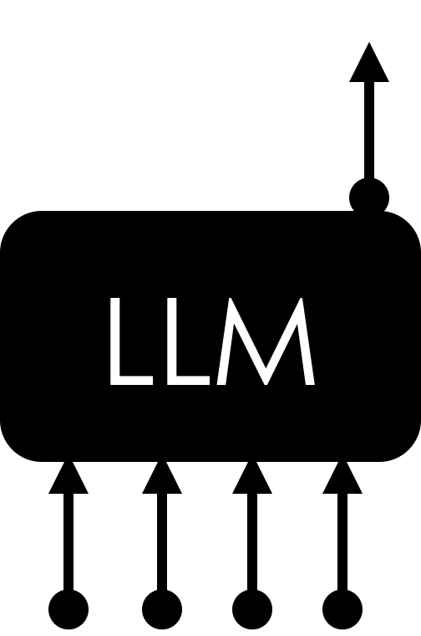
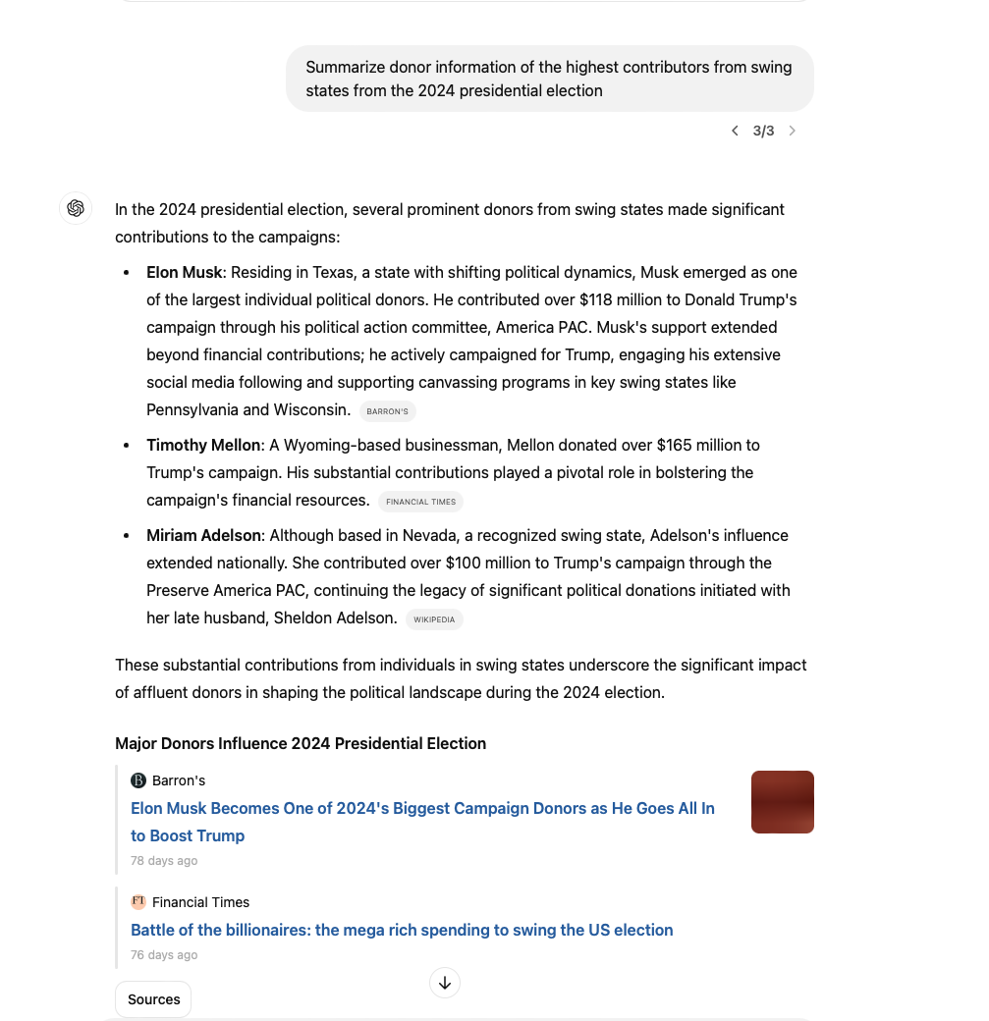
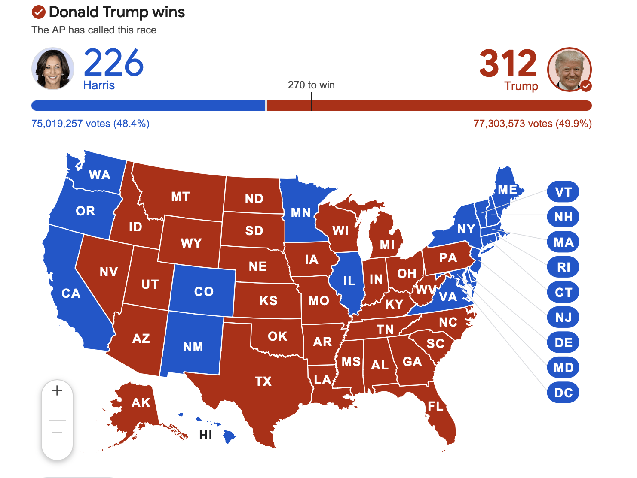
Towards Connecting AI to Data…
Summarize donor information of the highest contributors from swing states
Notes:
Going back to this question, we can begin to see the complex requirements of realistic user questions
and also the opportunities for combining LM capabilities with database ones

Slide 3
Summarize donor information of the highest contributors from swing states from the 2024 presidential election
In the 2024 presidential election, several prominent donors from swing states made significant contributions to the campaigns:
Elon Musk: Residing in Texas, a state with shifting political dynamics, Musk emerged as one of the largest individual political donors…
Timothy Mellon: A Wyoming-based businessman…
Miriam Adelson: Although based in Nevada…
RAG
Notes:
So I could ask a question like this to chatgpt, and openai's 4o models actually implement RAG under the hood using web search
And it'll give me this answer
At first glance this looks reasonable

Slide 4
Summarize donor information of the highest contributors from swing states from the 2024 presidential election
In the 2024 presidential election, several prominent donors from swing states made significant contributions to the campaigns:
Elon Musk: Residing in Texas, a state with shifting political dynamics, Musk emerged as one of the largest individual political donors…
Timothy Mellon: A Wyoming-based businessman…
Miriam Adelson: Although based in Nevada…
RAG
❌
Not a swing state
Notes:
But we know that Texas isn’t a swing state – it’s pretty well known in the US that Texas historically leans Republican,
and I asked specifically for the highest contributors from swing states
We can try to understand how the system incorrectly arrived at this answer,
and to do that, we can check out the source that the model cites, which is this article

Slide 5
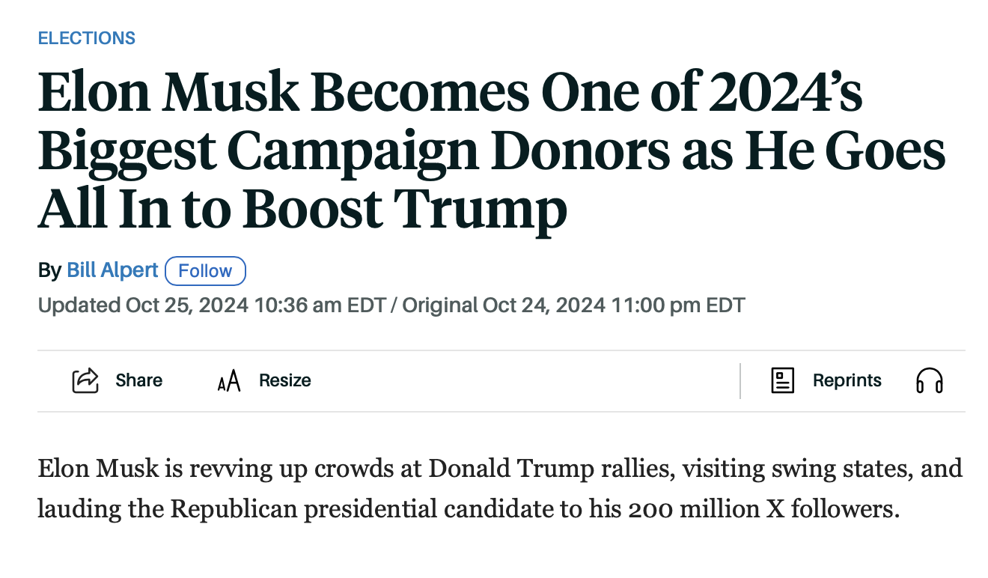
Summarize donor information of the highest contributors from swing states from the 2024 presidential election
❌
Not a swing state
Notes:
This is a new article talks about elon musk being one of the biggest 2024 campaign donors
And it also mentions that Elon musk visited swing states
Clearly the article looks semantically similar to my question, but its not quite the right information the model needs

Slide 6
How AI interacted with our data in 2024
RAG
Text2SQL
Data access limited to point lookups based on semantic similarity
❌
Notes:
And in general this is a limitation of RAG
the data access pattern is limited to point lookups based on semantic similarity search

Slide 7
Summarize donor information of the highest contributors from swing states
SELECT * FROM contributions
WHERE swing_state == True
❌
No data column for swing state
Text2SQL
Name | Transaction Amount | State | Occupation
Smith, Gerald | 9232024 | PA | Self-employed
… | … | … | …
Notes:
We can decompose this question
One piece here is I want to filter on contributors that are from swing states
- So I want to write a SQL statement like this, which is a selection filtering on the state’s party
- But I run into an issue here because there actually is no column for state party
- State parties can change over time and this represents world knowledge that isn’t explicitly stored in my data
But let’s assume for a second that I could some how get this data

Slide 8
Summarize donor information of the highest contributors from swing states
WITH (
SELECT * FROM contributions ORDER BY TRANSACTION_AMT DESC
) AS highest_contributions
SELECT * FROM highest_contributions WHERE swing_state == True
Need NL capabilities that go beyond SQL
❌
Text2SQL
Name | Transaction Amount | State | Occupation
Smith, Gerald | 9232024 | PA | Self-employed
… | … | … | …
Notes:
And now again I run into trouble because I need natural language capabilities for this that go beyond SQL and relational operators

Slide 9
Towards Connecting AI to Data…
Natural Language Capabilities
Exact Computation
(Parametric) World Knowledge
(Non-parametric)
Explicit Knowledge
Notes:
Specifically LLMs provide rich natural language reasoning and store a vast amount of world knowledge from their pretraining
On the other hand, databases provide scalable exact computation and let us work with explicit knowledge based on up-to-date stored data
And there’s a really rich design space to explore new systems that leverage these things together

Slide 10
Towards Connecting AI to Data…
Natural Language Capabilities
Exact Computation
TAG: Table Augmented Generation
(Parametric) World Knowledge
(Non-parametric)
Explicit Knowledge
Notes:
The VISION for TAG (Table Augmented Generation) is to unify these quadrants and combine the strengths of language models and data systems.

Slide 11
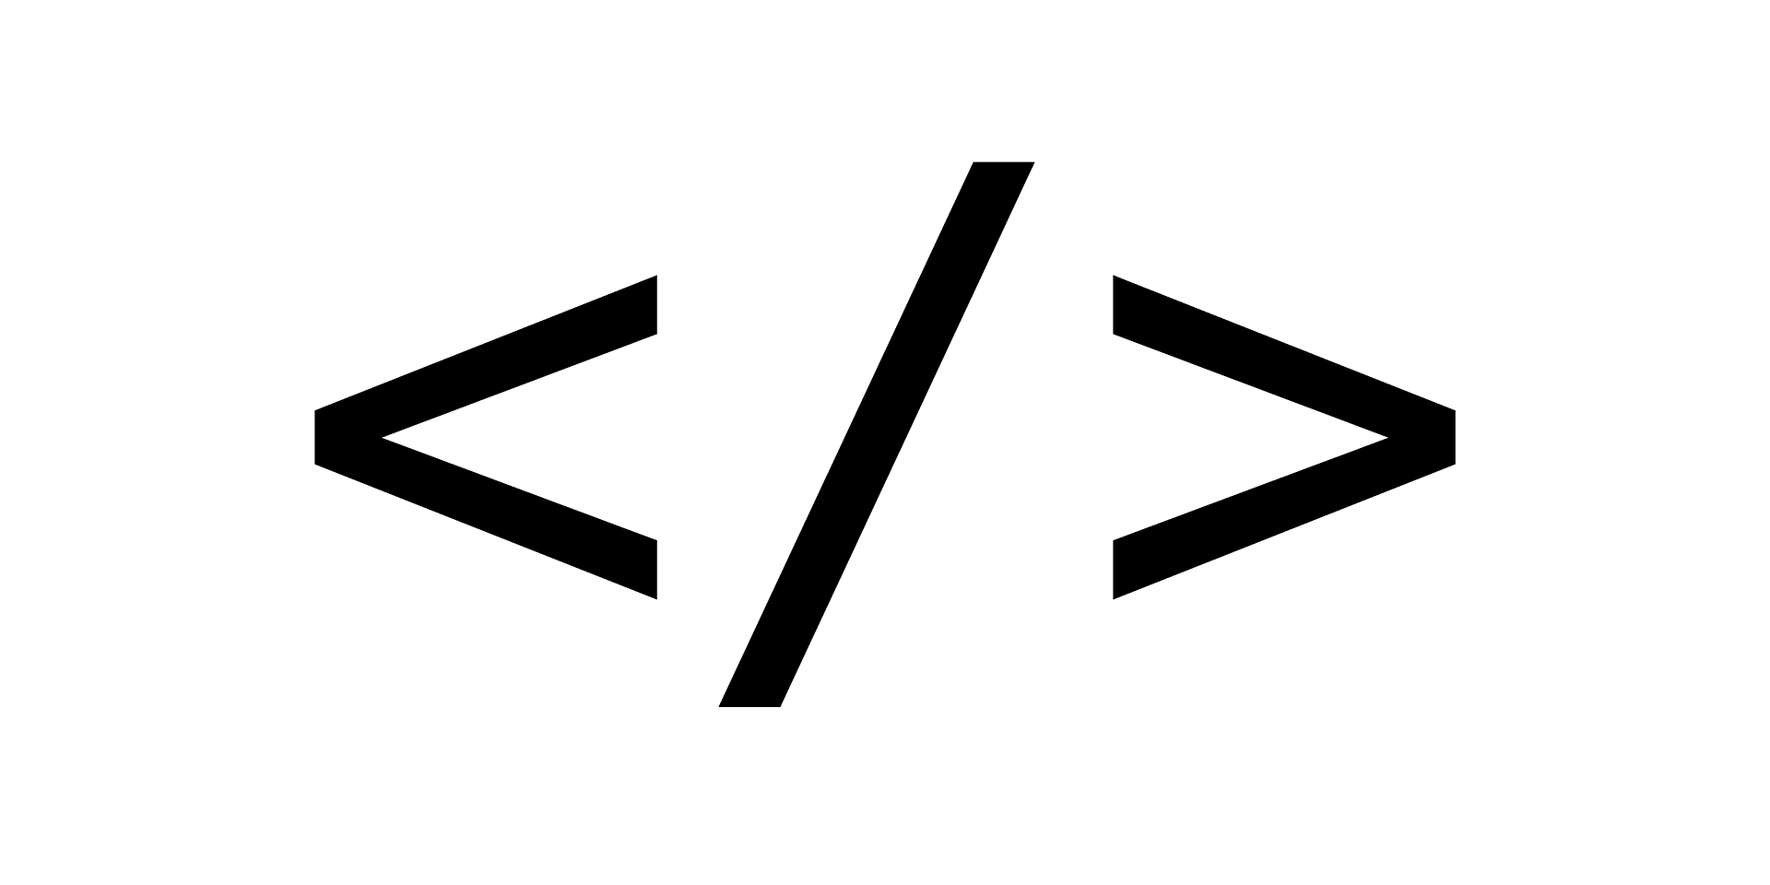
TAG: Table Augmented Generation
Query Synthesis
2
Query Execution
Answer Generation
1
3
How many…
NL Request →
Program
Notes:
.

Slide 12
TAG: Table Augmented Generation
Query Synthesis
2
Query Execution
Answer Generation
1
3
How many…
NL Request →
Program
Program
→ Data
Notes:
.

Slide 13
TAG: Table Augmented Generation
Query Synthesis
2
Query Execution
Answer Generation
1
3
How many…
The answer is…
NL Request →
Program
Program
→ Data
Data → NL Answer
Notes:
.

Slide 14
TAG: Table Augmented Generation
Query Synthesis
2
Query Execution
Answer Generation
1
3
Data sources
Relational tables
Vector stores
How many…
Unstructured data
The answer is…
Single call
Point lookup
Recursive
Summarization
LM UDFs
Aggregation
Semantic
operators
…
COT
Question types
Generation Patterns
Data → NL Answer
Execution APIs
NL Request →
Program
Program
→ Data
Notes:
.

Slide 15
TAG Execution Engine Example:
LOTUS
A query engine for LLM-powered data processing
pip install lotus-ai
github.com/guestrin-lab/lotus
Paper: arxiv.org/abs/2407.11418
Notes:
LOTUS is a query engine we've been building for LLM-powered data processing at Stanford and berkeley
I’ll very briefly talk about some of the key ideas, but you can find more about it in our paper and you can also pip install and try it out
Our goal with building LOTUS was to provide this optimized efficient execution engine that serves a core set of AI-based primitives that we repeatedly see in real applications

Slide 16
LOTUS Introduces Semantic Operators
Summarize donor information of the highest contributors from swing states
Query Synthesis
2
Query Execution
Answer Generation
1
3
Name | Transaction Amount | State | Occupation
Smith, Gerald | 9232024 | PA | Self-employed
… | … | … | …
sem_filter
ORDER BY
sem_agg
LM
LM
Select contributors from swing states
Find highest contributors
Summarize donor info
Bulk semantic processing
3
1
2
Notes:
and the job of the query engine is then to orchestrate the LLM over this large corpus in an efficient way
- execution engine needs to handle all the low level details of managing things like context space, api calls, batching, and various optimizations to get good performance and high quality results
-----
- Naïve execution over a lot of data could incur very high cost, involving multiple iterative or recursive calls to the LLM
- execution engine needs to handle all the low level details of managing things like context space, api calls, batching, and various optimizations to get good performance and high quality results

Slide 17
Evaluating TAG systems with TAG-Bench
Augment prior Text2SQL benchmark BIRD with world knowledge or reasoning components.*
School | GSOffered | City | Longitude
Fairlands | K-5 | Pleasanton | 121.8
… | … | … | …
Natural Language Capabilities
Exact Computation
california_schools
What is the grade span offered in the school with the highest longitude
(Parametric) World Knowledge
(Non-parametric)
Explicit Knowledge
in cities in that are part of the ’Silicon Valley’ region?
Notes:
We want to cover the entire quadrant, with questions that require natural language reasoning capabilities and world knowledge not directly present in the table.

Slide 18
Evaluating with TAG-Bench
Execution Accuracy (%)
Text2SQL
Text2SQL + LM
< 20% Accuracy
Method
RAG
RAG + Rerank
Hand-written TAG
using LOTUS
55% Accuracy
0.0
20.0
40.0
60.0
Notes:
On the x-axis we’ll have execution accuracy for our benchmark, consisting of 60 non aggregation queries.
Zero-shot Text2SQL (where the SQL generated is executed on the SQLite DB to get the answer), answers just 17% of queries correctly
RAG (with E5 embedding model and FAISS index) is unable to answer a single question correctly, limited to point lookups on single tables and unable to capture the complexity of joins required for the benchmark queries.
We also evaluate two stronger baselines, including Text2SQL followed by an LM generation step along with RAG + Rerank baseline where retrieved rows are assigned a score from 0 to 1 before input into the model.
An overview of our evaluation confirms that prior methods were unsuccessful in answering these complex queries.
Handwritten TAG pipelines, implemented with LOTUS operators (which you’ll hear more about in the next talk), showcase the potential of TAG systems

Slide 19
What’s in the future?
Methods leveraging more of the TAG design space will outperform baselines
TAG-Bench 2.0: expand benchmark with harder queries
Notes:
From our evaluation, we can safely predict that new tag methods that leverage more of the rich design space will outperform baselines. In other words, Text2SQL won’t be enough on its own.
Also, TAG-Bench is still being actively worked on! We’re looking forward to quickly providing more queries to test on.

